Slide 1
Logistic Regression and Classification in R
Prof. Tom Willemain
T. R. Willemain

Slide 2
Overview of Logistic Regression
Use when the response is binary (0/1)
  Live/Die, Yes/No, Type A/Type B
Predicting P = Pr[Y=1|predictors X₁, X₂…X_{n}] Logit = “log odds” = Log[ P/(1-P) ] = β₀ + Σβ_{i}X_{i}
  P = 1/[ 1+exp(-{β₀ + Σβ_{i}X_{i}}) ]
Fit by maximum likelihood estimation
Often also used for binary classification
  If Logit > Threshold => “yes” else “no”
T. R. Willemain

Slide 3
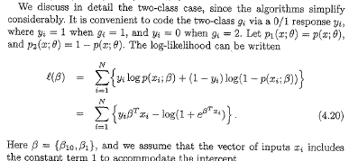
Maximum Likelihood Estimation
Source: Hastie, Tibshirani and Friedman, “The Elements of Statistical Learning”, Springer, 2001.
T. R. Willemain

Slide 4
Deviance
  Deviance is the analog of SSerror in ordinary regression, so want it to be small
Deviance = LogLikelihood for fitted model minus LogLikelihood for perfect model
  = LogLikelihood for fitted model – log(1)
Partial deviance = LogLikelihood for model with fewer parameters – LogLikelihood for model with more parameters
Asymptotically, partial deviance ~ Chisquare with d.f. = difference in # parameters
T. R. Willemain

Slide 5
Doing Logistic Regression in R
Read in data with a binary response.
  x = read.table()
Use the “general linear model” function with a “binomial” link function.
  logit = glm(y~x1+x2, binomial, na.action=na.exclude)
Use the “summary” function to see results.
  summary(logit)
Use the “predict” function to get fits to logits and then convert to predictions of P[“success”]
  predicted=predict(logit, na.action=na.exclude)
  prob=1/(1+exp(-predicted))
T. R. Willemain

Slide 6

Doing Binary Classification
Determine a “threshold” for the predicted probability of “success”.
Classify cases as follows:
  predicted probability > Threshold is “Type 1”.
  predicted probability ≤ Threshold is “Type 0”.
Assess predictive performance with a “confusion matrix”
T. R. Willemain

Slide 7
Example: Predicting Bad Air Days
We will create a binary response indicating days with high ozone levels.
We will fit a logistic regression model to the data.
We will use the model predictions to decide whether to call a given day a “bad air” day.
We will assess the predictions using a “confusion matrix”.
T. R. Willemain

Slide 8
> # logit.demo.R
>
> # shows how to do logistic regression
> # by predicting worst ozone days
>
> # initialize
> rm(list=ls())
>
> # get data on NYC air quality
> data(airquality)
attach(airquality)
> head(airquality)
Ozone Solar.R Wind Temp Month Day
1 41 190 7.4 67 5 1
2 36 118 8.0 72 5 2
3 12 149 12.6 74 5 3
4 18 313 11.5 62 5 4
5 NA NA 14.3 56 5 5
6 28 NA 14.9 66 5 6
T. R. Willemain
Notes:
Would want to carry this on to a confusion matrix.

Slide 9
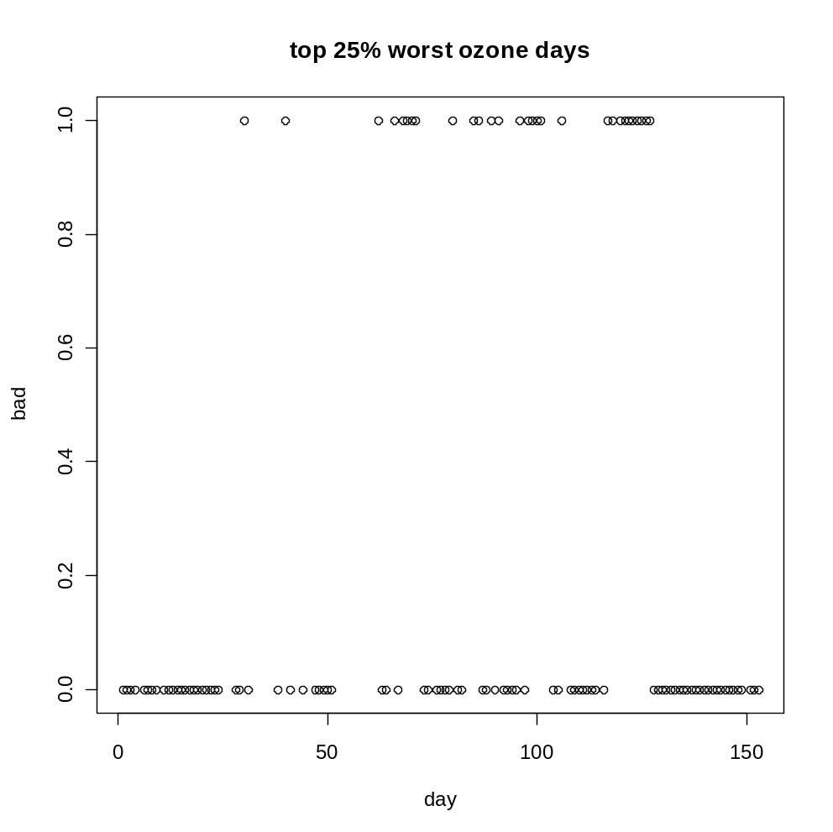
> # create binary response from Ozone data
> bad=ifelse(Ozone>quantile(Ozone,0.75,na.rm=T),1,0)
> plot(bad,xlab="day",ylab="bad",main="top 25% worst ozone days")
> 100*table(bad)/sum(table(bad)) # confirm %75 good and 25% bad days
bad
0 1
75 25
T. R. Willemain

Slide 10
> # fit model with all possible terms
> logit=glm(bad~Solar.R*Wind*Temp, binomial, na.action=na.exclude)
Warning message:
glm.fit: fitted probabilities numerically 0 or 1 occurred
> summary(logit)
Call:
glm(formula = bad ~ Solar.R * Wind * Temp, family = binomial,
na.action = na.exclude)
Deviance Residuals:
Min 1Q Median 3Q Max
-1.833e+00 -1.468e-01 -1.082e-02 -2.107e-08 2.964e+00
Coefficients:
Estimate Std. Error z value Pr(>|z|)
(Intercept) -4.842e+01 6.355e+01 -0.762 0.446
Solar.R 3.017e-01 3.426e-01 0.881 0.378
Wind 2.989e+00 5.078e+00 0.589 0.556
Temp 5.883e-01 7.877e-01 0.747 0.455
Solar.R:Wind -5.013e-02 3.413e-02 -1.469 0.142
Solar.R:Temp -3.296e-03 4.127e-03 -0.799 0.424
Wind:Temp -3.961e-02 6.483e-02 -0.611 0.541
Solar.R:Wind:Temp 5.672e-04 4.015e-04 1.413 0.158
(Dispersion parameter for binomial family taken to be 1)
Null deviance: 123.163 on 110 degrees of freedom
Residual deviance: 31.625 on 103 degrees of freedom
(42 observations deleted due to missingness)
AIC: 47.625
Number of Fisher Scoring iterations: 9
T. R. Willemain

Slide 11
> # fit reduced model
> logit2=glm(bad~Wind+Temp,binomial, na.action=na.exclude)
> summary(logit2)
Call:
glm(formula = bad ~ Wind + Temp, family = binomial, na.action = na.exclude)
Deviance Residuals:
Min 1Q Median 3Q Max
-1.846757 -0.155790 -0.014764 0.005884 2.645521
Coefficients:
Estimate Std. Error z value Pr(>|z|)
(Intercept) -38.4515 11.1485 -3.449 0.000563 ***
Wind -0.6074 0.1928 -3.150 0.001630 **
Temp 0.5109 0.1384 3.693 0.000222 ***
---
Signif. codes: 0 ‘***’ 0.001 ‘**’ 0.01 ‘*’ 0.05 ‘.’ 0.1 ‘ ’ 1
(Dispersion parameter for binomial family taken to be 1)
Null deviance: 130.462 on 115 degrees of freedom
Residual deviance: 38.499 on 113 degrees of freedom
(37 observations deleted due to missingness)
AIC: 44.499
Number of Fisher Scoring iterations: 8
T. R. Willemain

Slide 12
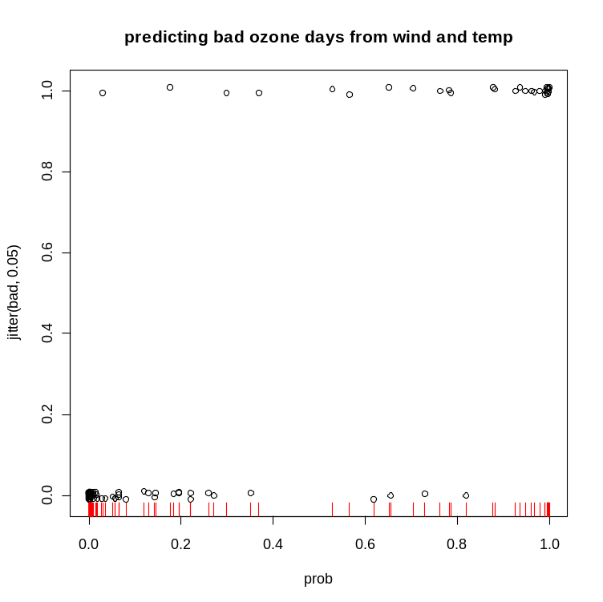
> # get predicted log odds
> logodds=predict.glm(logit2,na.action=na.exclude)
>
> # convert logits to probabilities
> prob=1/(1+exp(-logodds))
>
> # show actual values vs their predicted probabilities
plot(prob,jitter(bad,0.05),
main="predicting bad ozone days from wind and temp")
> rug(prob,col="red") # adds a "rug plot" along the X axis
T. R. Willemain

Slide 13
> # pick threshold for calling it a "bad" day
> for (T in seq(0.1,0.9,0.1)){
+ called.bad=ifelse(prob>T,1,0)
+ # compute confusion matrix
+ cat("threshold=",T,"\n")
+ confusion=table(called.bad,bad)
+ cat("confusion matrix:","\n")
+ print(confusion)
+ pctcorrect=100*(confusion[1,1]+confusion[2,2])/sum(confusion)
+ cat("% correct=",round(pctcorrect,1),"\n")
+ print("---------------------")
+ }
threshold= 0.1
confusion matrix:
bad
called.bad 0 1
0 71 1
1 16 28
% correct= 85.3
[1] "---------------------"
threshold= 0.2
confusion matrix:
bad
called.bad 0 1
0 78 2
1 9 27
% correct= 90.5
[1] "---------------------"
threshold= 0.3
confusion matrix:
bad
called.bad 0 1
0 82 3
1 5 26
% correct= 93.1
[1] "---------------------"
threshold= 0.4
confusion matrix:
bad
called.bad 0 1
0 83 4
1 4 25
% correct= 93.1
threshold= 0.5
confusion matrix:
bad
called.bad 0 1
0 83 4
1 4 25
% correct= 93.1
[1] "---------------------"
threshold= 0.6
confusion matrix:
bad
called.bad 0 1
0 83 6
1 4 23
% correct= 91.4
[1] "---------------------"
threshold= 0.7
confusion matrix:
bad
called.bad 0 1
0 85 7
1 2 22
% correct= 92.2
[1] "---------------------"
threshold= 0.8
confusion matrix:
bad
called.bad 0 1
0 86 11
1 1 18
% correct= 89.7
[1] "---------------------"
threshold= 0.9
confusion matrix:
bad
called.bad 0 1
0 87 13
1 0 16
% correct= 88.8
T. R. Willemain

Slide 14
Some Comments
Logistic regression is one of several methods for classifying cases into 2 groups.
Other methods allow classification into more than 2 groups, including another version of logistic regression.
Best to assess performance using held-out data.
It seems, in practice, that more important than choice of classification method is choice of “features” describing the cases.
T. R. Willemain

Slide 15
In-Class Exercise
Read in the TRW dataset spam.email.csv.
Make a logistic regression model that computes the probability that a given message is spam.
Convert that result into a predicted type: spam or not.
Assess performance using a confusion matrix.
T. R. Willemain

Slide 16
# logistic.spam.R
rm(list=ls())
x=read.csv("spam.email.csv",header=T)
dim(x)
head(x)
attach(x)
logit=glm(spam~.,family=binomial,data=x) # kitchen-sink model; slim down later
summary(logit)
spamosity=predict(logit)
plot(density(spamosity))
threshold=0
abline(v=threshold,col="red")
boxplot(spamosity~spam,ylab="spamosity",xlab="spam?")
abline(h=threshold,col="red")
type=ifelse(spamosity<=threshold,0,1)
tt=table(spam,type)
tt
false.pos.rate =tt[[3]]/(tt[[1]]+tt[[3]])
false.neg.rate =tt[[2]]/(tt[[2]]+tt[[4]])
cat("threshold=",threshold,"false pos rate=",round(false.pos.rate,2),"false neg rate=",round(false.neg.rate,2),"\n")
detach(x)
T. R. Willemain

Slide 17
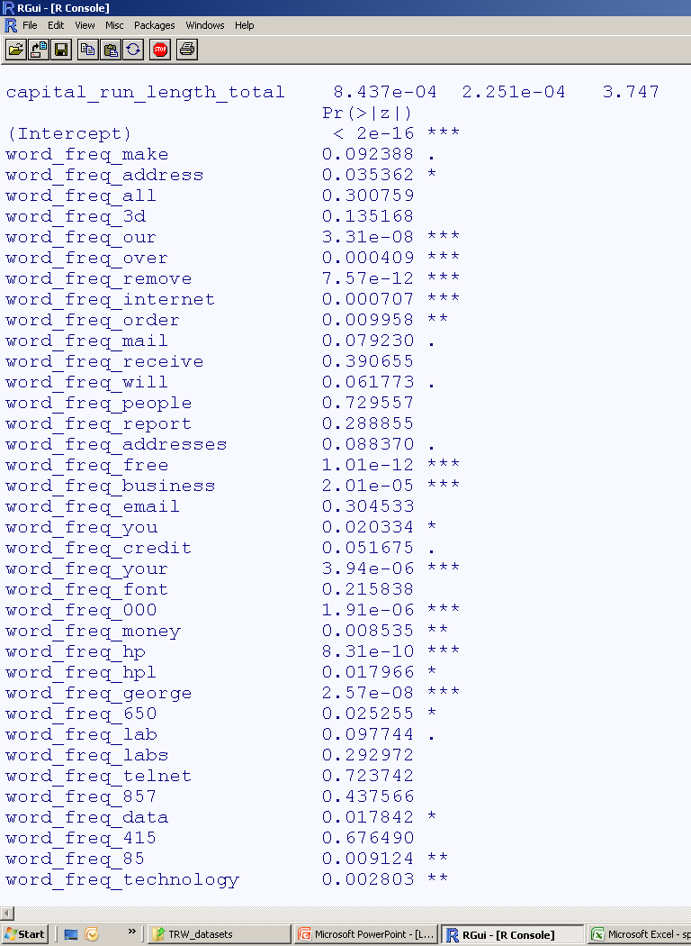
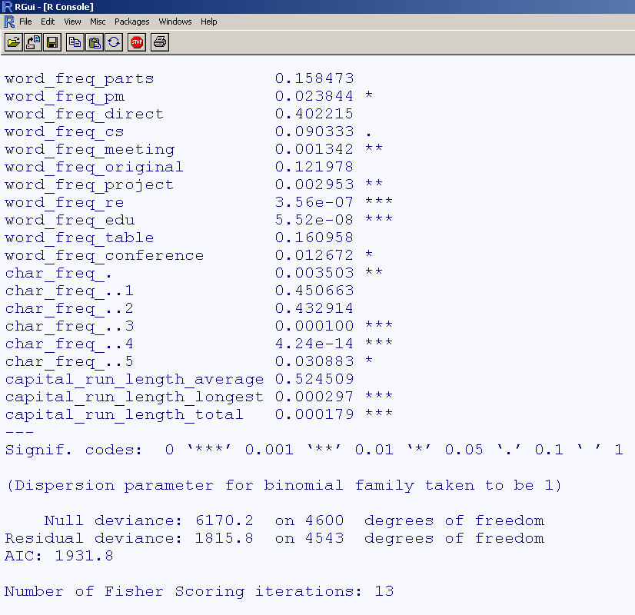
Holy kitchen sink, Batman!
T. R. Willemain

Slide 18
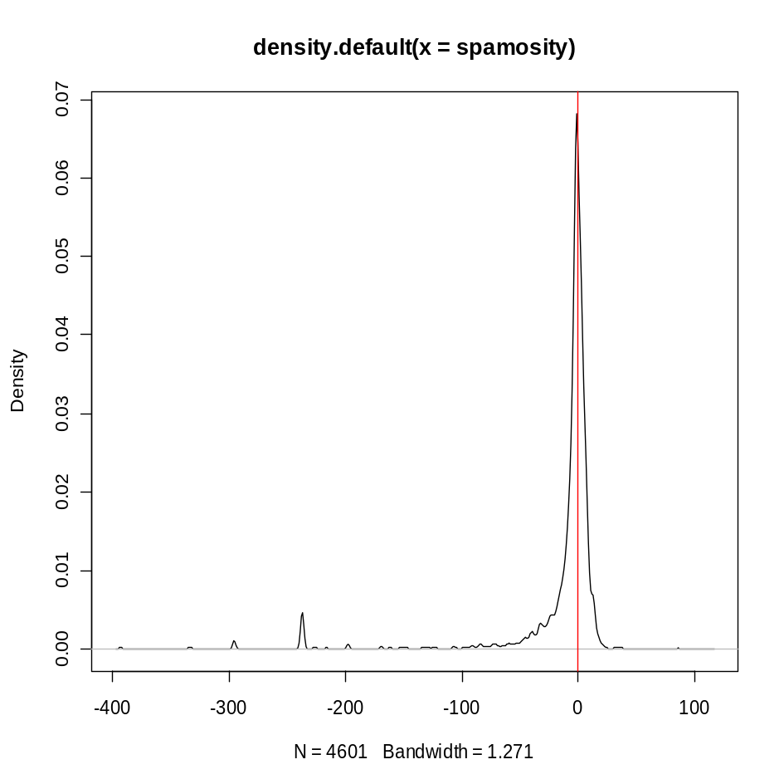
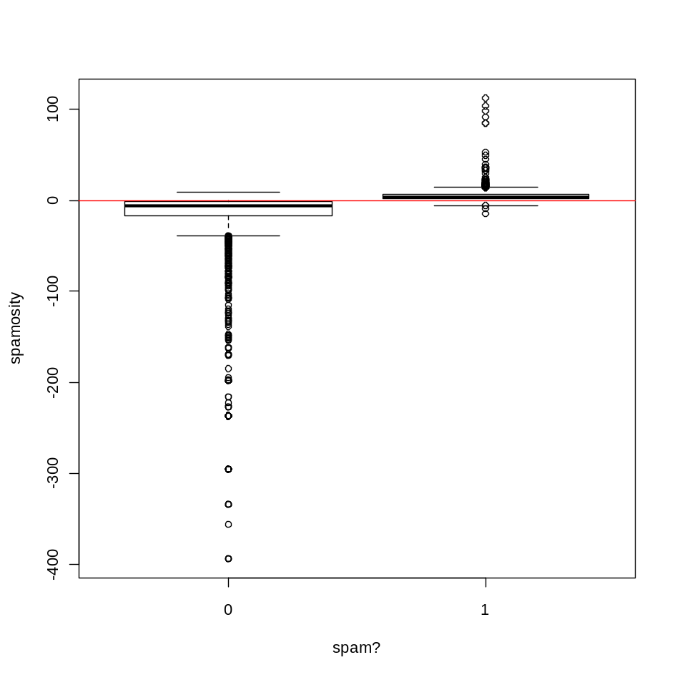
Let’s pick a threshold and see how it does.
T. R. Willemain

Slide 19
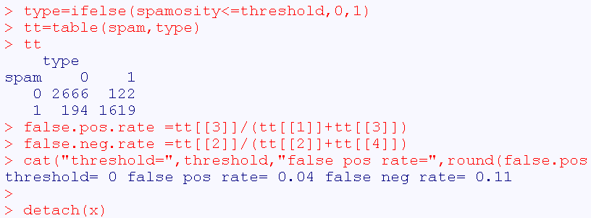
T. R. Willemain

